Slide 1
GIT- Cherry Pick
Presentation By:
Group 11

Slide 2
What Is git cherry-pick
According to the official git documentation, the goal of a cherry-pick is to “apply the changes introduced by some existing commit.” Essentially, a cherry-pick will look at a previous commit in the repository’s history and apply the changes that were part of that earlier commit to the current working tree. The definition is seemingly straight forward, yet in practice there is a great deal of confusion over what exactly happens when someone tries to git cherry-pick a commit, or even cherry-pick from another branch. This git cherry-pick example will eliminate that confusion.

Slide 3
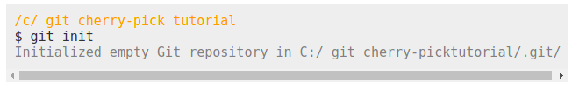
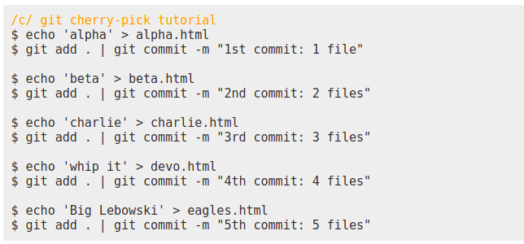
A git cherry-pick example
We will begin this git cherry-pick example with a completely clean repository, which means first you will create a new folder, which we will name git cherry-pick tutorial, and then issuing a git init command from within it.
With the git repository initialized, create five html files, and each time a you create a file, perform a commit. In each commit message, the commit number and the number of files in the working tree will be included as part of the commit message. In a subsequent step, where we cherry-pick a commit, it is one of these commit steps that will be chosen.
Here are the commands to create the five, alphabetically ordered .html files along with the git commands required to add each file independently to the git index and subsequently commit those files to the repository:

Slide 4
A note on the echo command
The echo command will be used as a file creation shortcut. For those unfamiliar with this shortcut, echoing text and then specifiying a file name after the greater-than sign will create a new file with that name, containing the text that was echoed. So the following command will create a new file named agenda.html with the word devops contained within it:

Slide 5

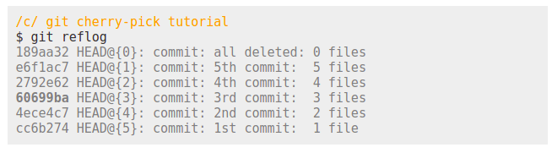
Delete and commit before the cherry-pick
We will now delete all five recently created files to clear out the working directory. A subsequent commit will be needed here as well.
To recap, five files were created, and each file created has a corresponding commit. And then all the files were deleted and a sixth commit was issued. A chronicling of this commit history can be concisely viewed in the reflog. Take special note of the hexadecimal identifier on the third commit, which we will cherry-pick in a moment:

Slide 6
What happens when we git cherry-pick a commit?
This is where the git cherry-pick example starts to get interesting. We need to git cherry-pick a commit, so let’s choose the third commit where the file named charlie.html was created. But before we do, ask yourself what you believe will happen after the command is issued. When we git cherry-pick a commit, will we get all of the files associated with that commit, which would mean alpha.html, beta.html and charlie.html will come back? Or will we get just one file back? Or will the attempt to git cherry-pick a commit fail since all of the files associated with the commit have been deleted from our workspace?

Slide 7
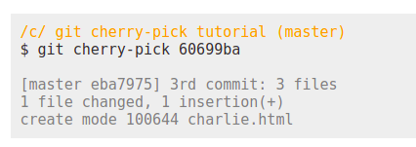
The git cherry-pick command
Here is the command to git cherry-pick commit number 60699ba:

Slide 8
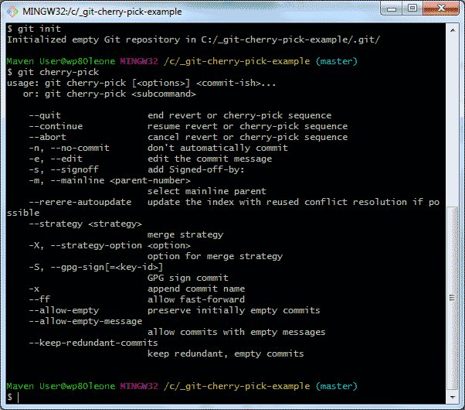
As you can see, only one file was added to the working directory, namely charlie.html. The files that were added to the repository in prior commits were not added, which tends to be the expectation of many users. Many users believe that when you git cherry-pick a commit, all of the files that are part of that branch, at that time of the commit, will be brought into the working directory. This is obviously not the case. When you git cherry-pick a commit, only the change associated with that commit is re-applied to the working tree.

Slide 9
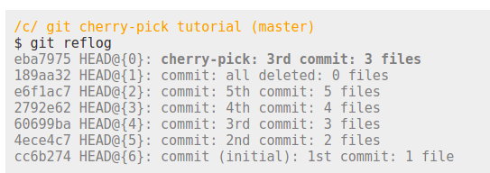
A hidden git cherry-pick commit
It should also be noted that it’s not just the working tree that is updated. When you git-cherry-pick a commit, a completely new commit is created on the branch, as the following reflog command indicates:

Slide 10
Group 11 Team Members:
Harshal Dubey
Gaurav Raj
Pardeep Chaurasiya
Kartikay
Yogesh Sharma

Slide 11
Thank You

